Slide 1
Lab 4:
FoldTree
Presented by Hua Bai
Original Slides by Rebecca Alford and Steven Lewis
Aug 30th, 2016

Slide 2
So far
Managing changes to the code (Git)
How to test your code is working
Building your first Rosetta protocol
Move by manually setting phi/psi
Macromolecular modeling requires more sophisticated sampling moves
In this Lab
How internal coordinates are used in Rosetta’s molecular representation
Learning about the FoldTree and AtomTree
Using the FoldTree in your protocols
Modeling a protein by secondary structure elements with the FoldTree

Slide 3
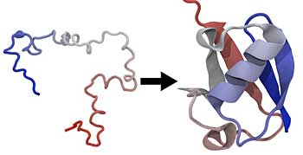
Problem: Folding a protein
Sequence
Long Extended Chain
Structure
Folded tertiary structure

Slide 4
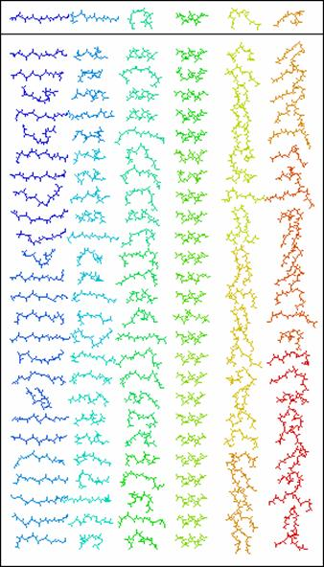
Ab Initio Folding in Rosetta
Insertion of 3 and 9 residue fragments, update torsions
Evaluate energy of updated pose and accept favorable structures

Slide 5
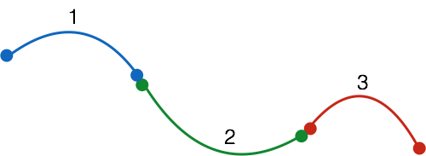
Altering Middle Fragment

Slide 6
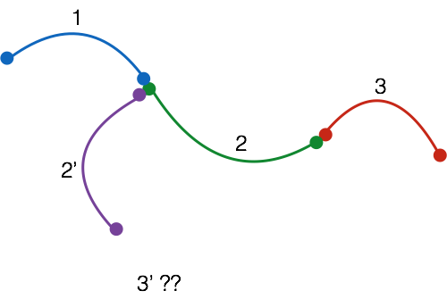
Altering Middle Fragment

Slide 7
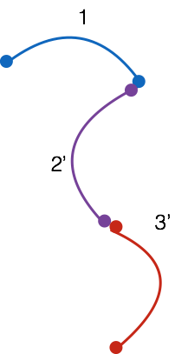
How do coordinates get updated?
How do we know the direction in which to propagate change?
Notes:
and how do we know what direction to move in?

Slide 8
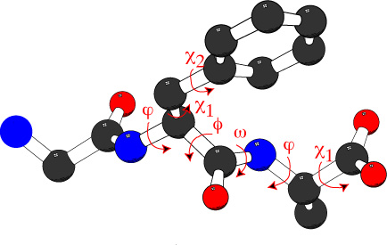
Rosetta uses internal coordinates
Torsions of each atom described by positions of its previous connections

Slide 9
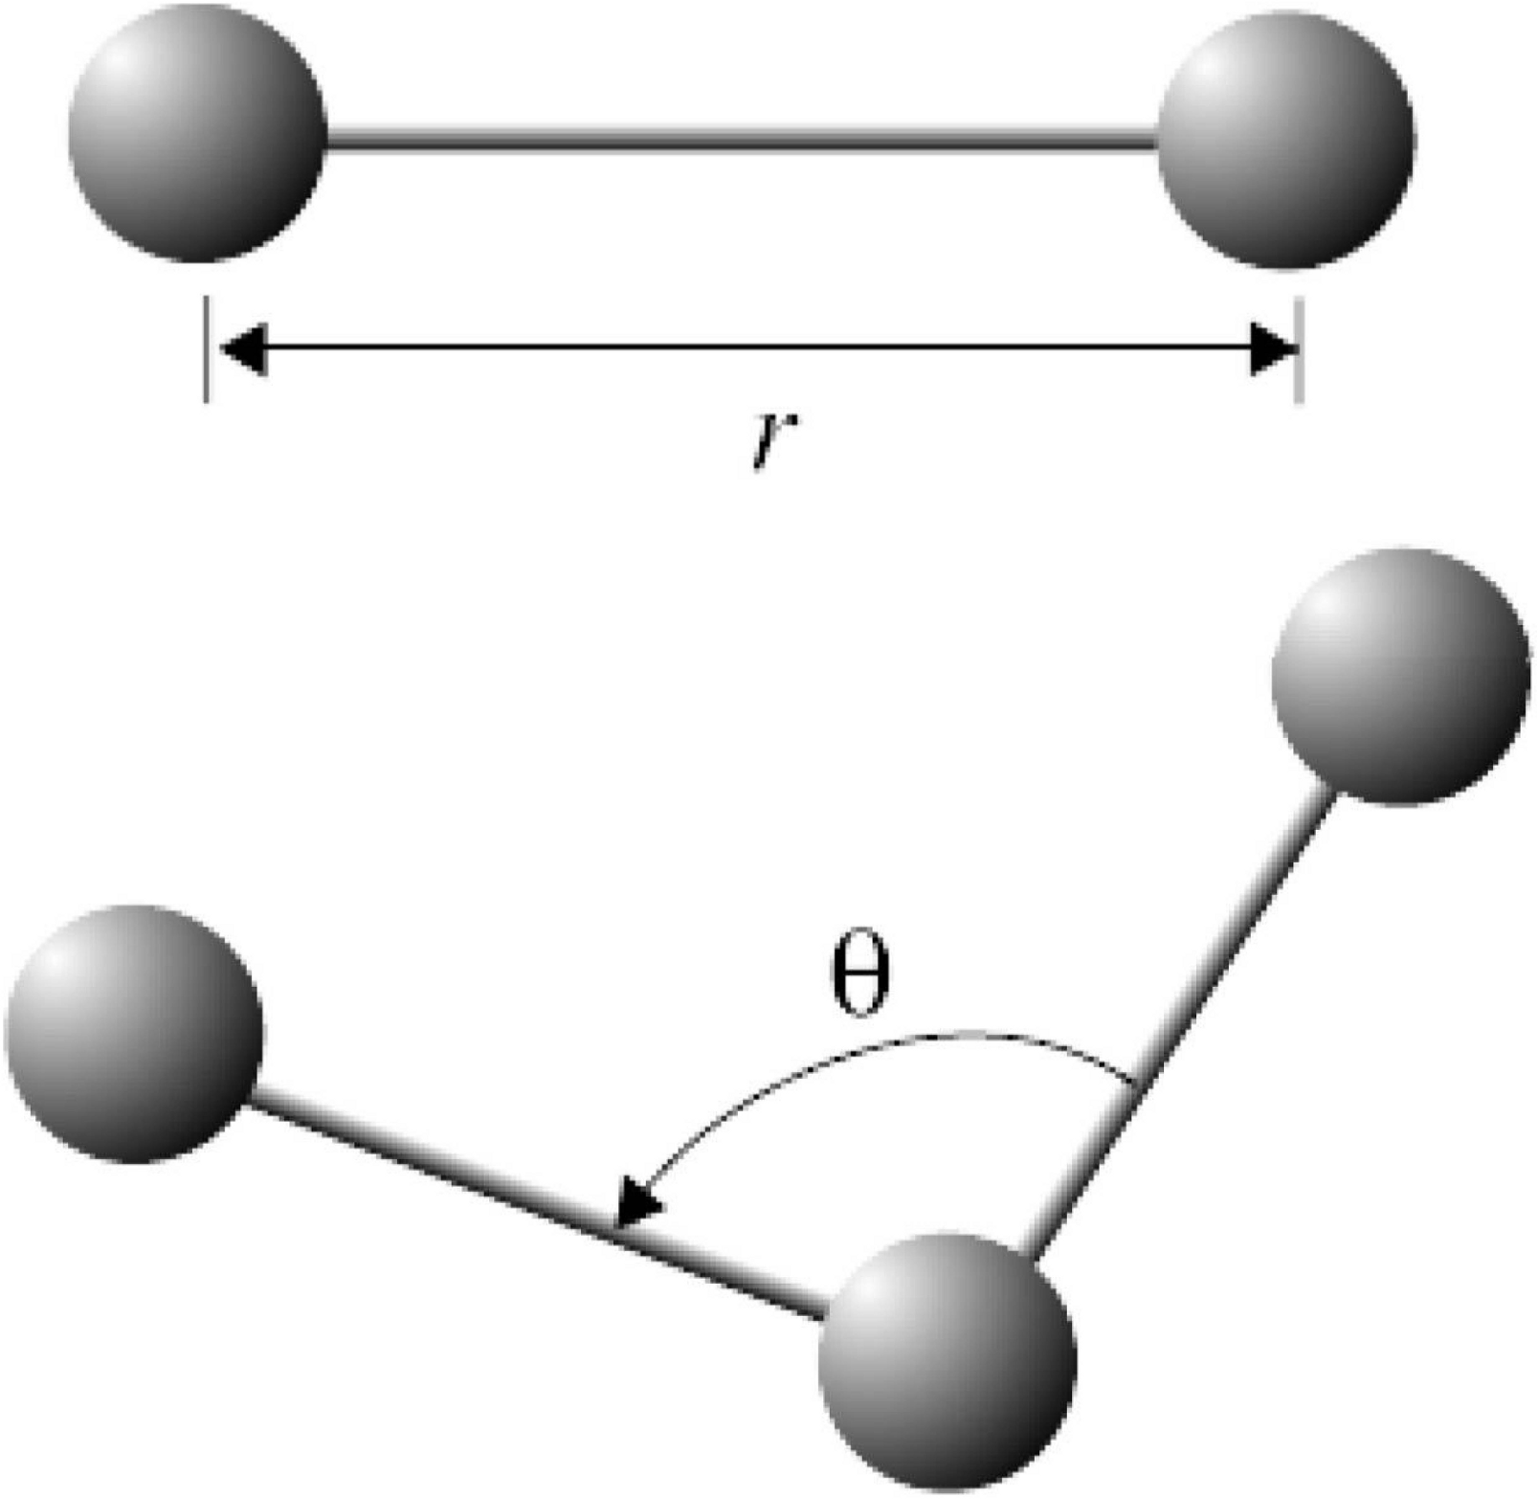
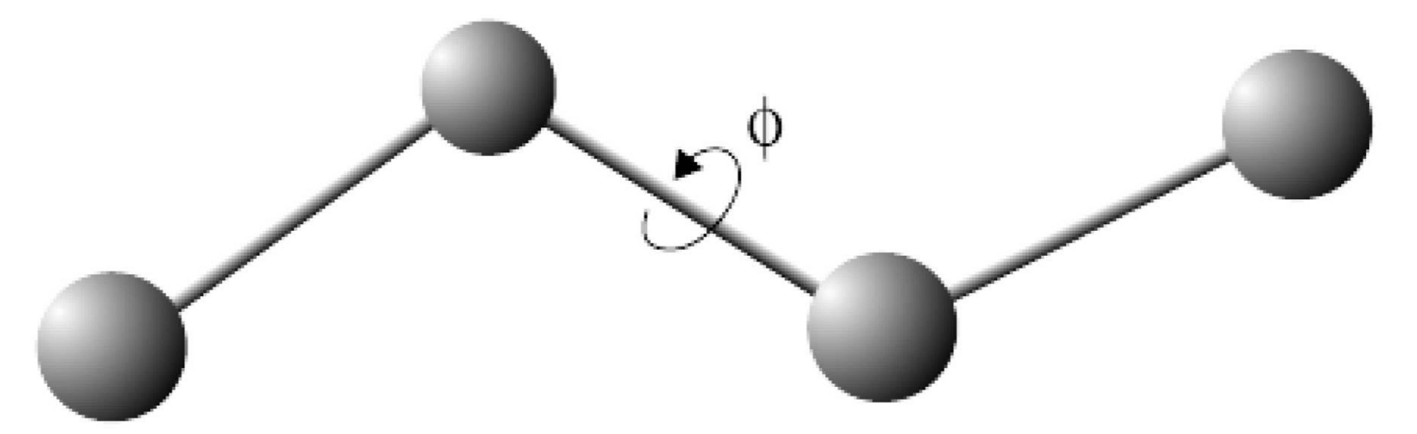
Internal coordinate system
Instead of X, Y, Z, we use:
bond length (2 atoms)
bond angle (3 atoms)
bond torsion (4 atoms)
Still 3 DOFs to determine a point
First 3 atoms special-cased
All others depend on previous
atoms
images from NAMD tutorial

Slide 10
Internal Coordinates’ Consequence
Effects:
Changes in one residue propagate downstream
Small changes in internal coordinates result in large changes in cartesian coordinates
Sometimes pro, sometimes con

Slide 11
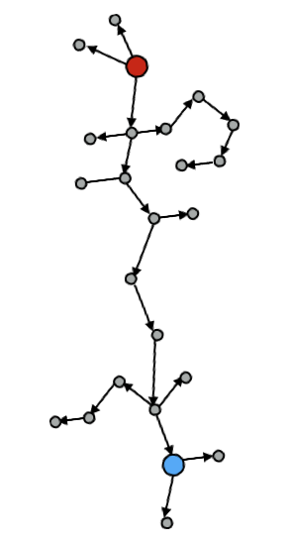
Recursive Refolding
How To Fold:

Slide 12
Recursive Refolding
Root
How To Fold:
Start at the root atom and update its coordinates using update_xyz_coords( root )

Slide 13
Recursive Refolding
How To Fold:
Start at the root atom and update its coordinates using update_xyz_coords( root )
Update the coordinates of its children

Slide 14
Recursive Refolding
How To Fold:
Start at the root atom and update its coordinates using update_xyz_coords( root )
Update the coordinates of its children
Traverse the tree

Slide 15
Recursive Refolding
How To Fold:
Start at the root atom and update its coordinates using update_xyz_coords( root )
Update the coordinates of its children
Traverse the tree

Slide 16
Recursive Refolding
Do this recursively (like in fib hw):
void update( vertex ){
update_xyz_coords();
if ( num_children = 0 ) return;
else
update( children );
}

Slide 17
Recursive Refolding
Do this recursively (like in fib hw):
void update( vertex ){
update_xyz_coords();
if ( num_children = 0 ) return;
else
update( children );
}

Slide 18
Recursive Refolding
Do this recursively (like in fib hw):
void update( vertex ){
update_xyz_coords();
if ( num_children = 0 ) return;
else
update( children );
}

Slide 19
Recursive Refolding
Do this recursively (like in fib hw):
void update( vertex ){
update_xyz_coords();
if ( num_children = 0 ) return;
else
update( children );
}

Slide 20
Recursive Refolding
Do this recursively (like in fib hw):
void update( vertex ){
update_xyz_coords();
if ( num_children = 0 ) return;
else
update( children );
}

Slide 21
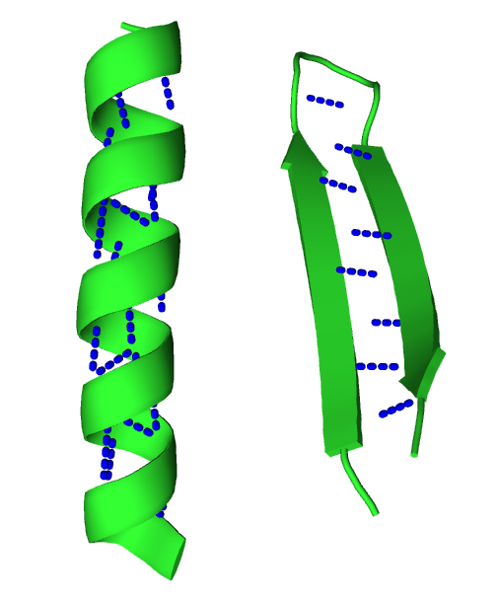
Proteins are not just linear chains
Propagation disrupts long-range interactions
Helices have short contact order
H-bond is i->i+4
Sheets have arbitrarily large contact order
What will change in that loop do to the sheet?

Slide 22
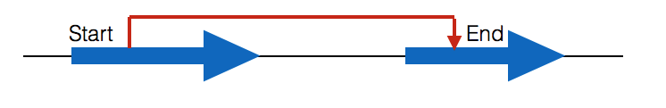
How to maintain long-range interactions?
The “jump”
non-chemical kinematic dependence between elements
Route around areas we don’t want to propagate through!

Slide 23
Internal Coordinates’ Consequence
Why use internal coordinates?
Hugely efficient for certain calculations
Less efficient for others (van der Waals)
Almost all protein motion is in rotating torsions
Torsion-centric representation actually natural

Slide 24
Internal Coordinates Caveat
ICs are a kinematic system that describe geometric connectivity
not necessarily the same as chemical connectivity
Is a directed acyclic graph (DAG)*
Consequence: missing chemical bonds!
Cyclic side-chains (WYFH, P)
Disulfides (cyclize the main chain)
*Actually, a directed tree - DAG is underspecific, but emphasizes the pertinent features
Notes:
fold tree is residue level, atom tree is atom level
APL NOTE: For precision here, it’s actually a directed tree. If you were to take all the directed edges in a DAG and replace them with undirected edges, it’d be ok for the resulting graph to have cycles. e.g.
G = {V,E}; V = {a,b,c}; E = { (a,b), (b,c), (a,c) };
G is a DAG, but the undirected version, G’ = {V,E’}, E’ = { {a,b}, {b,c}, {a,c} } has a cycle.

Slide 25
How do we interface with ICs?
core::kinematics::AtomTree class maintains an internal coordinate connectivity representation of a pose
atom-centric
core::kinematics::FoldTree class is a more user-friendly interface* to AtomTree
residue-centric, but can address atoms
*This is the biggest lie featured in this talk

Slide 26
AtomTree’s components
Directed acyclic graph (DAG)
One vertex per atom
Stub - local coordinate frames, centered on atoms
rotational relationships between stubs are internal coordinate DOFs
BondedAtom - chemically & kinematically connected, like you’d expect
JumpAtom - kinematic connection demanded by the programmer, but not chemically present
Contains the recursive refolding algorithm we already discussed

Slide 27
FoldTree’s components
Vertices
Residues of interest - where we intervene in default connectivity
Edges attach to vertices
Edges? Vertices? FoldTree is a graph! (directed, acyclic graph)
FoldTree is edge-centric

Slide 28
FoldTree’s Edges
Peptide edges
“fold like normal”
Jump edges
User-defined IC connections

Slide 29
FoldTree Components: Peptide Edges
Works for all polymers: DNA, RNA, protein
Contiguous span of residues
Edge #: -1 (core::kinematics::Edge::PEPTIDE)
Intermediate residues must be polymer residues
Because Rosetta is folding from general chemical knowledge

Slide 30
FoldTree Components: Jump Edges
Relate 2 local coordinate frames
Force residue 2 to depend on residue 1, not its neighbors
Connect parts of the molecular system (usually) not connected by a polymer bond
Edge #: unique positive integer, up to # jumps
Requires a cutpoint - to maintain acyclic in DAG

Slide 31
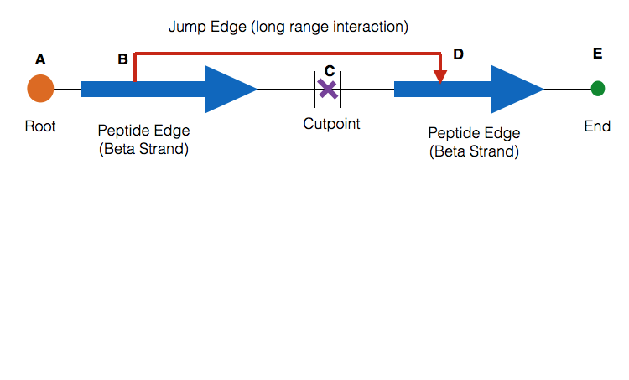
How the FoldTree Mediates Folding
Jump
Peptide edges:
A->B
B->C
D->C+1
D->E
Jump edges:
B->D

Slide 32
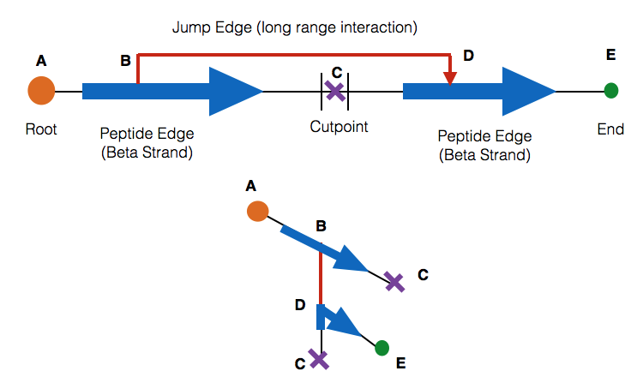
How the FoldTree Mediates Folding
Jump
Peptide edges:
A->B
B->C
D->C+1
D->E
Jump edges:
B->D
C+1

Slide 33
FoldTree Interface: Overview
Add an Edge to the Fold tree
void FoldTree::add_edge( core::Size start,
core::Size end,
Edge e )
Adding a new Jump edge to the fold tree
void FoldTree::new_jump( core::Size start,
core::Size end,
core::Size cutpoint )
Set the root residue
void FoldTree:reorder( vertex )
Check your fold tree respects all of the rules
void FoldTree::check_fold_tree()

Slide 34
FoldTree Interface: Adding Edges
Primary interface for today’s lab: ft.add_edge
void add_edge( int start,
int end,
int const label
);
Start Index: Upstream Position
End Index: Downstream Position
Last Argument: Edge Type
- core::kinematics::PEPTIDE (means -1)
- Jump number n, n = {1…num jumps}
This function signature is accurate, but can anyone poINT out a strange feature?

Slide 35
FoldTree Interface: Add Jump Edge
Can also add a jump edge by specifying jump and cutpoint, inserting new PEPTIDE edges automatically
void new_jump( int jump_pos1,
int jump_pos2,
int cutpoint
);
Jump Pos1: Upstream jump root
Jump Pos2: Downstream jump target
Last Argument: Cutpoint position
This function signature is accurate, but can anyone poINT out a strange feature?

Slide 36
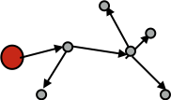
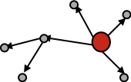
FoldTree Interface: Reordering
Direction of edges matters in folding. Always point from start -> stop
Can fix directionality to all point downstream from the root of your tree using:
bool FoldTree::reorder( int const root );

Slide 37
FoldTree: Important Rules
All residues present (most hidden in PEPTIDE edges)
All residues traversable from one root atom
No cycles, directed acyclic graph
Order matters: folding happens along edges
Checking for these rules:
bool FoldTree::check_fold_tree() const;

Slide 38
How to Use FoldTree with Pose
Pose functions (member functions of class Pose):
Get the FoldTree from the pose:
pose.fold_tree() returns FoldTree const &
Assign a new FoldTree to the Pose
pose.fold_tree(FoldTree const & ft_in);

Slide 39
How to Use FoldTree with Eyeballs
Showing the FoldTree
member function of FoldTree:
void FoldTree::show( std::cout out );
FoldTree also defines operator<<
std::cout << ft << std::endl;
FOLD_TREE EDGE 1 59 -1 EDGE 59 85 1 EDGE 85 78 -1 EDGE 85 90 -1 EDGE 90 132 -1 EDGE 132 133 -1 EDGE 90 76 2 EDGE 132 143 3 EDGE 76 60 -1 EDGE 76 77 -1 EDGE 143 134 -1 EDGE 143 152 -1

Slide 40
Dealing with cycles
Broadly, cycles handled by the score function
Some term penalizes a “gap” between bonded atoms
Chemical cycles
Intra-residue cycles handled automatically (HWFY)
Internal ring DOFs never sampled, “fixed”
Proline has pro_close score function term
Disulfides have disulfide score function term
Notes:
Previously overlooked - we have a cycle in a sidechain but no way of ensuring it gets closed when we update coords

Slide 41
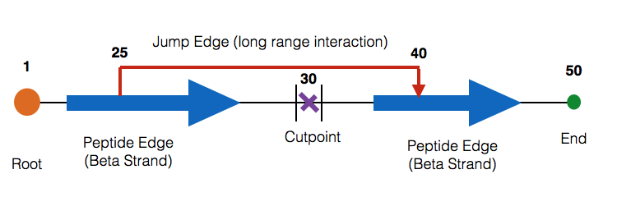
Dealing with cycles
Jump-caused cycles: a chemical connection, not present in the FoldTree, necessitated by a jump
Chainbreak scorefunction term/patches handle
Jump
Notes:
Previously overlooked - we have a cycle in a sidechain but no way of ensuring it gets closed when we update coords

Slide 42
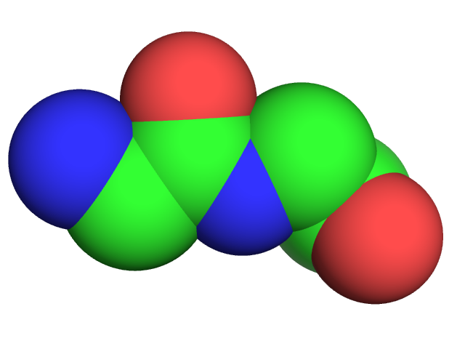
Chainbreak term & variants
Notes:
Previously overlooked - we have a cycle in a sidechain but no way of ensuring it gets closed when we update coords

Slide 43
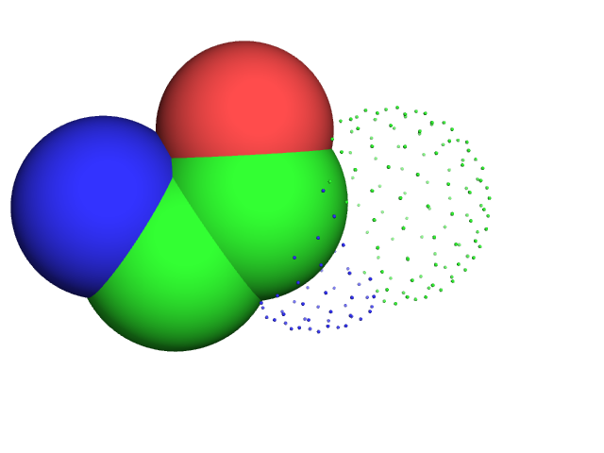
Chainbreak term & variants
CUTPOINT_LOWER
CAV_{i}
NV_{i}
Notes:
Previously overlooked - we have a cycle in a sidechain but no way of ensuring it gets closed when we update coords

Slide 44
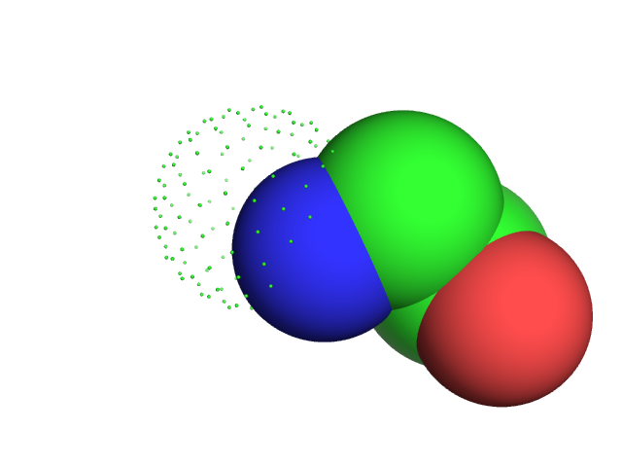
Chainbreak term & variants
CUTPOINT_UPPER
CV_{i+1}
Notes:
Previously overlooked - we have a cycle in a sidechain but no way of ensuring it gets closed when we update coords

Slide 45

Chainbreak term & variants
Score grows with matched atoms’ distances
C_{i}/CV_{i+1}
CAV_{i}/CA_{i+1}
NV_{i}/N_{i+1}
Nonzero weight to linear_chainbreak (or others) to activate scoring
Notes:
Previously overlooked - we have a cycle in a sidechain but no way of ensuring it gets closed when we update coords

Slide 46
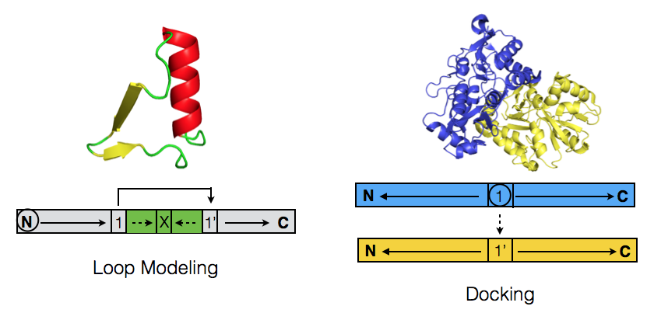
FoldTree - Modeling Applications
Wang, C., Bradley, P., & Baker, D. (2007). Protein-protein docking with backbone flexibility. Journal of molecular biology, 373(2), 503–19. doi:10.1016/j.jmb.2007.07.050
Notes:
APL NOTE: Can you give and walk through working code that creates these two fold trees as examples? I would like the students to have a reference point for how to create fold trees since that’s going to be an important part of the lab they’ll be performing.
E.g.
core::kinematics::FoldTree ft;
ft.add_edge( 1, 15, core::kinematics::Edge::PEPTIDE );
ft.add_edge( 15, 20, core::kinematics::Edge::PEPTIDE );
ft.add_edge( 15, 27, 1 );
ft.add_edge( 27, 21, core::kinematics::Edge::PEPTIDE );
ft.add_edge( 27, 52, core::kinematics::Edge::PEPTIDE );
Here it is worth pointing out that, by convention, the cutpoint is at residue 20 -- even though you might think that it’d be more accurate to say the cutpoint is between residue 20 and residue 21.

Slide 47
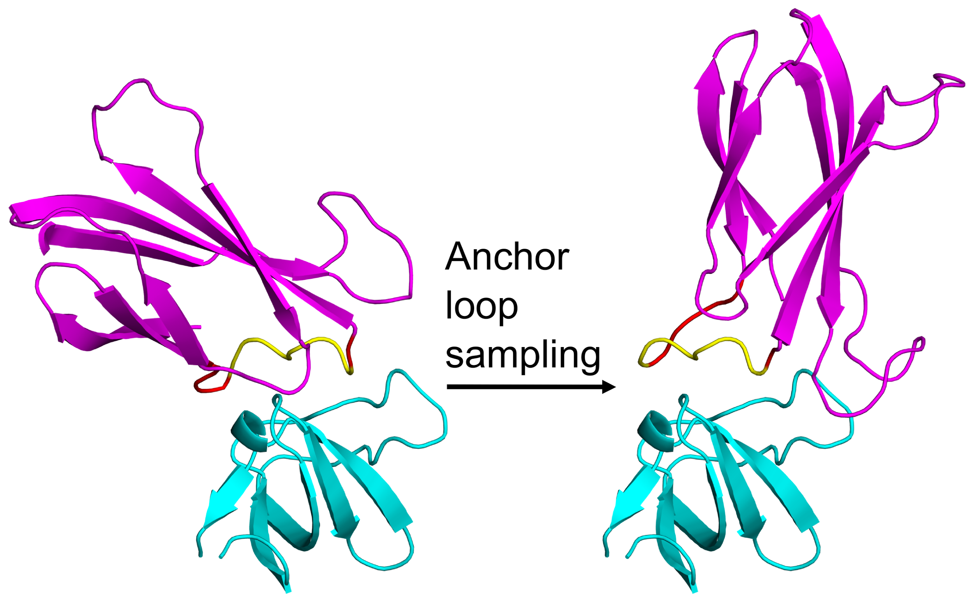
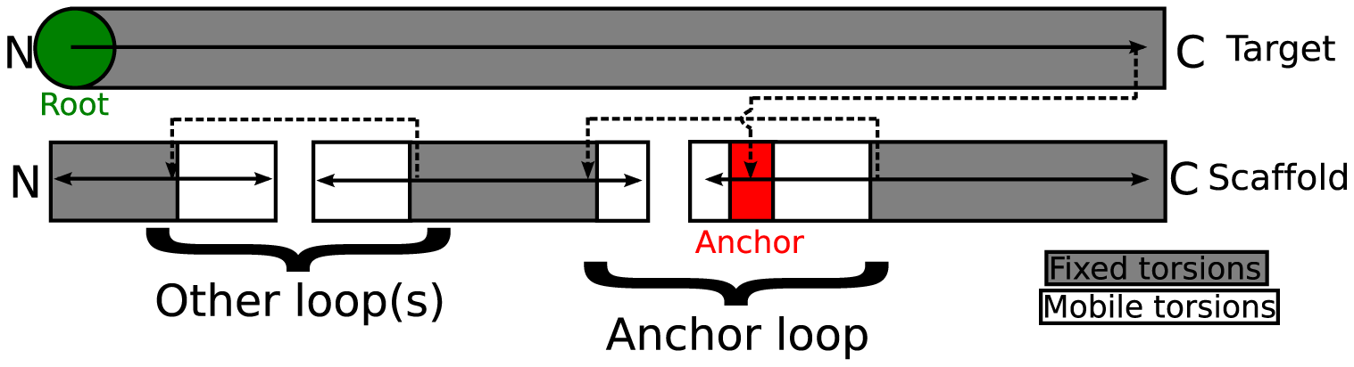
FoldTree - Modeling Applications
Lewis SM, Kuhlman BA (2011) Anchored Design of Protein-Protein Interfaces. PLoS ONE 6(6): e20872. doi:10.1371/journal.pone.0020872

Slide 48
Additional Steps: MoveMap
Previously discussed: MoveMap designates what DOFs are allowed to move in the structure
Use mm.set_jump( true ) to allow minimization of jumps
Jumps are all-DOF, not just torsion rotation! Length, angle can change.

Slide 49
DSSP
“Define Secondary Structure of Proteins”
IDs H-bonds electrostatically, then SS elements
string of H (helix) and E (sheet); everything else is loop*

Slide 50
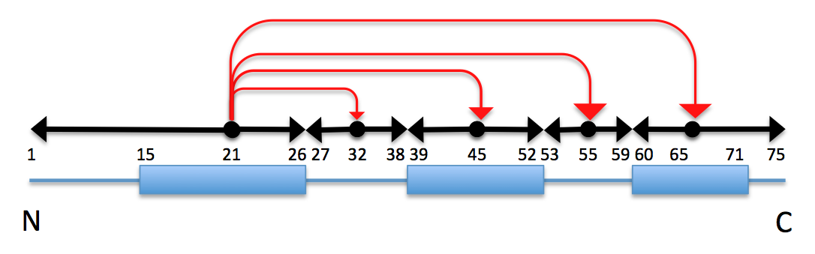
Lab Overview
Test MC rejection rate in protocol
Write and test a function that converts DSSP SS into a list of SS element start/stop pairs (Edges)
Write and test a function that takes a DSSP SS and makes a SS-structured fold tree for that pose
Move the code to protocols
Use this code to set a new fold tree for your protocol, and observe that the rejection rate falls with FoldTree-enforced localized sampling

